Slide 1
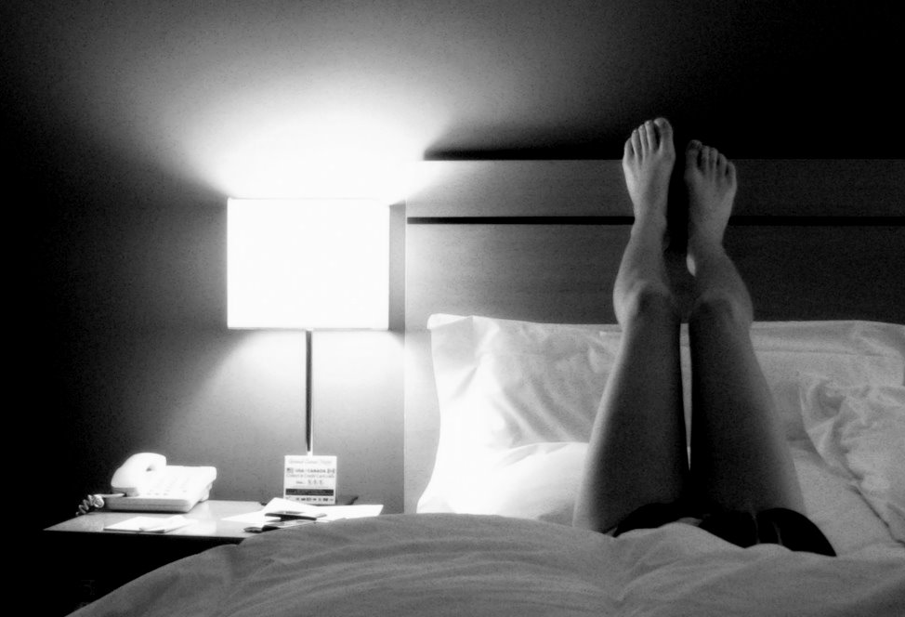
The Room
Enter story

Slide 2
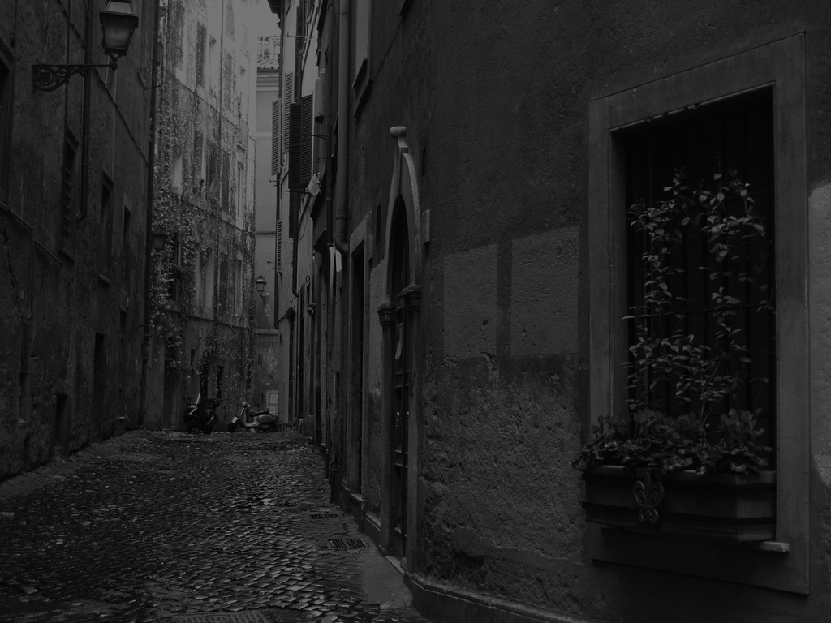
It is the first night of summer. Their laughter echoes in the narrow streets as they leave the small bar somewhere in Rome. They don’t know where they are and the alcohol prevents them from caring about it. He takes her hand and she starts running. He doesn’t move. She stops. “What’s wrong?” “Where do you want to go?” he asks and tries to remember her name.
Not interested
Read on

Slide 3
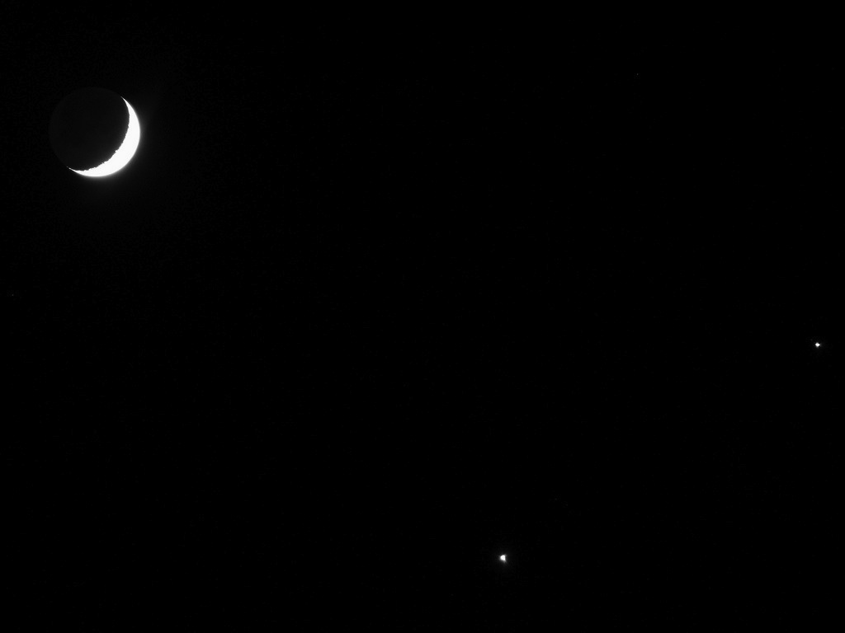
“I don’t know. Come on, let’s look for summer. I’ve lost mine somewhere.” She adds, “It’s the shortest night of the year.” “So we should make the most of it,” he answers. As a cab passes them she waves to stop it. “Where can I bring you?” asks the driver in a strong Eastern European accent. She leans forward and points to the moon.
His point-of-view
Her point-of-view

Slide 4
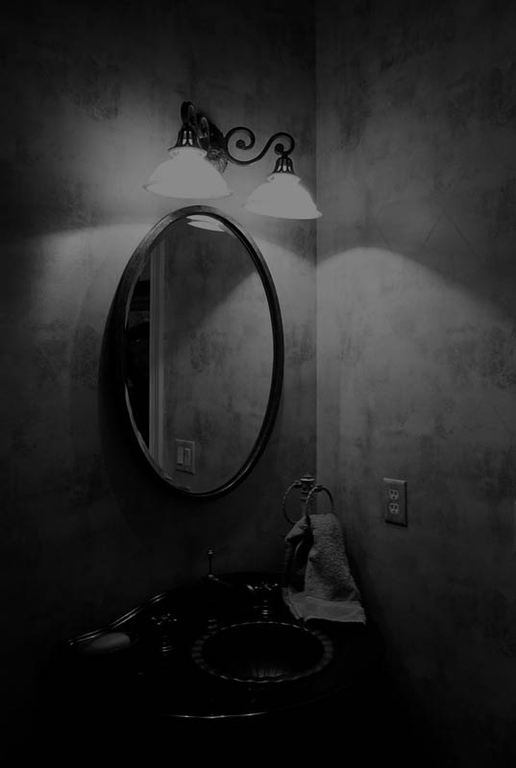
He has drawn the curtains. Some moonlight shines through the narrow gap. It divides the room into two parts. He turns from the balcony door and walks to the desk. Above is an oval shaped mirror. It hasn’t been cleaned in a while and has several scratches at the edges as it had been moved a lot. It takes him a moment until he recognizes his reflection. There is nothing he could say to himself.
He lies down on the bed
He walks to the bathroom door

Slide 5
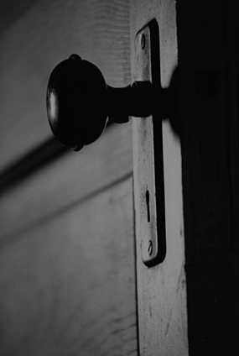
He walks to the bathroom door. She has been in there for quite some time and he wants to come to the point. After all, he didn’t take her to his hotel room to wait for her all night long.
“Hey –” He can’t remember her name.
“Are you all right?” he says and knocks at the door.
No answer.
She turns the doorknob.

Slide 6
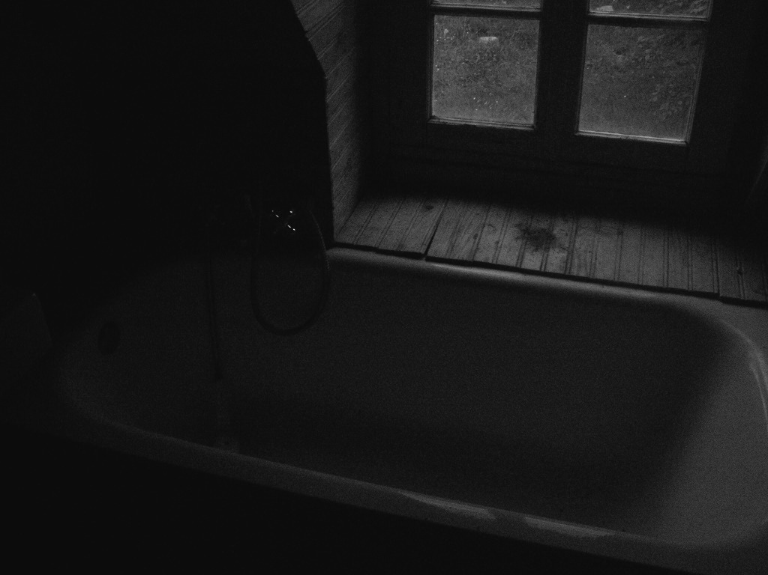
No answer. He moves closer to the door and tries to eavesdrop. Nothing. He slowly turns the doorknob. She sits next to the dirty, white bathtub and cries. “Are you okay?” She shakes her head. “I should go,” she says, wipes her tears away and gets up.
He takes her hand.
He is not moving.

Slide 7
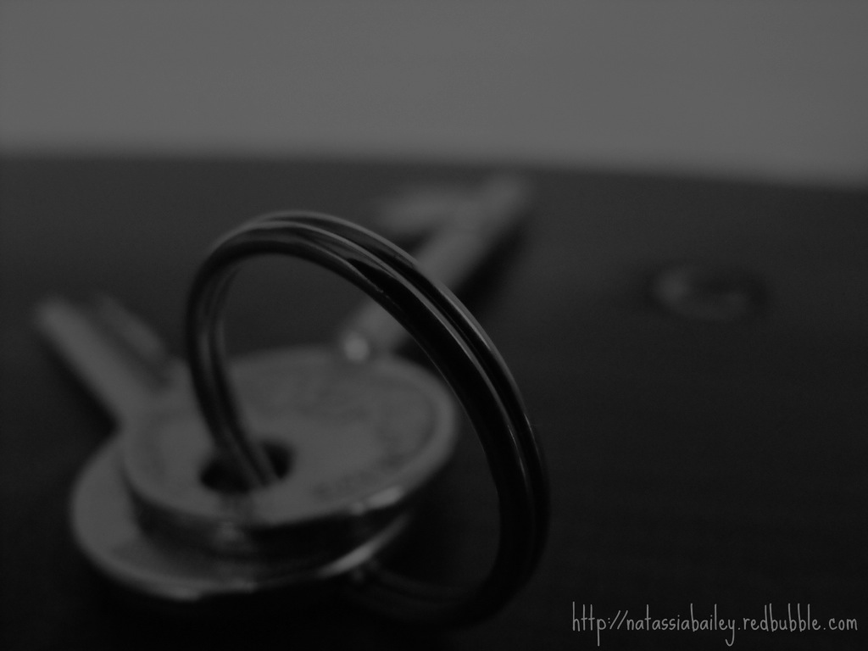
He doesn’t move. He clenches his fists. His knuckles turn white. As she closes the door to his hotel room he waits for a few minutes before he grabs his keys and leaves. He’d go to the bar again. “So close,” he thinks. “So fucking close.”
Write a different ending

Slide 8
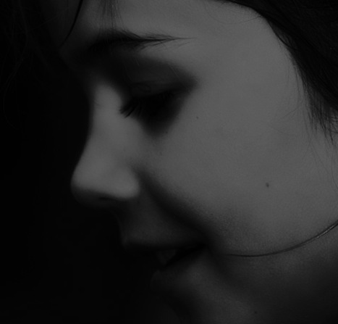
He takes her hand as she walks by. “I’m sorry,” he says. She stops and looks at him. “I am engaged,” she blurts out like a child who couldn’t keep the secret anymore. “Why are you here then?” “I don’t know.” She looks away. “No one has to know about this but us.” He gets closer to her face. Her scent reminds him of the sandalwood incense sticks his mother used to burn all over the house because the smell calmed her down. “I don’t want this to affect my life,” she says. He kisses her.
His point-of-view
Her point-of-view

Slide 9
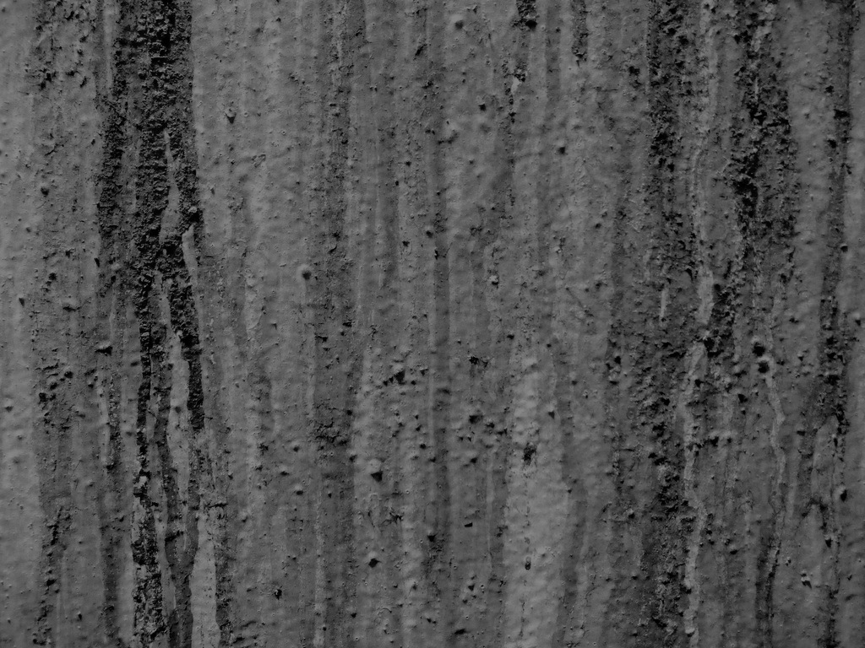
He lies down on the bed and stares at the high ceiling. The water stains make the painted, naked women from ancient times look dirty. It was the cheapest room he could get so he didn’t expect much. She has been in the bathroom for quite some time. “I’m going back to Spain tomorrow. This is my last night in Rome,” he remembers her saying at the bar. Every other word has drowned in the alcohol.
He can hear noises in the bathroom.
He falls asleep.

Slide 10
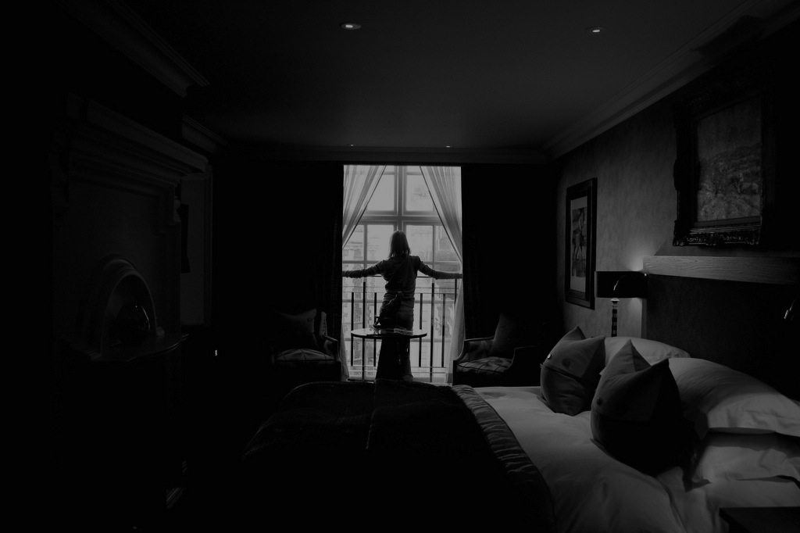
After some time he can hear noises in the bathroom. The door opens. It’s silent again. Is she watching me? he thinks, and sits up. She starts walking around and lets her fingers slide along the wall, along faces and naked bodies. At some spots the plaster crumbles. Diana’s index finger is gone. “It’s nice here,” she says. He remains silent. She stops at the balcony door and parts the curtains.
“It’s too dark in here,” she says.
“What are you doing?”

Slide 11
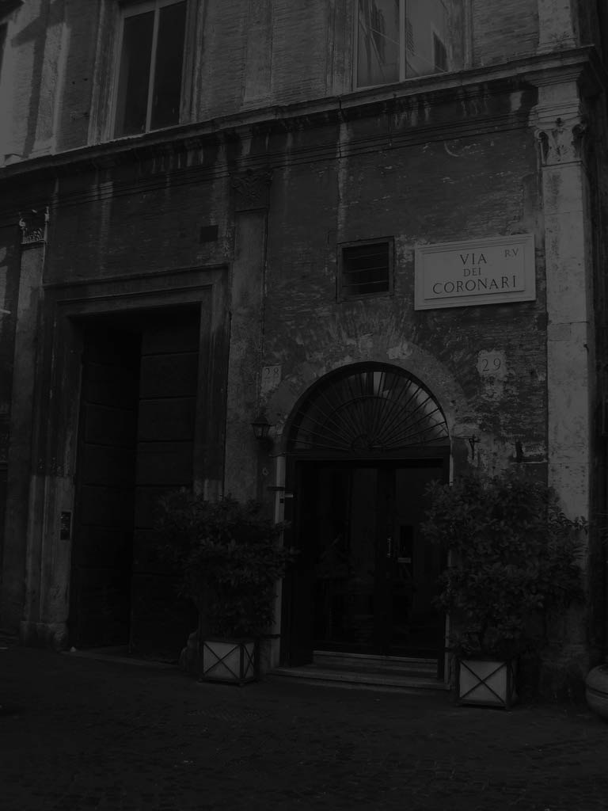
“It’s too dark in here,” she says. He fiddles with his shirt and replies silently, “I thought it would be nicer that way.” She turns towards the window and touches the glass of the door with her fingertips. She follows the silhouette of the moon. The moonlight makes her long auburn hair shine. “The street,” she says, “where are we?” He points at the street sign. “Via dei Coronari,” she reads and gives herself over to the room again.
“Someone knocked.”
“Is this your first time in Rome?”

Slide 12
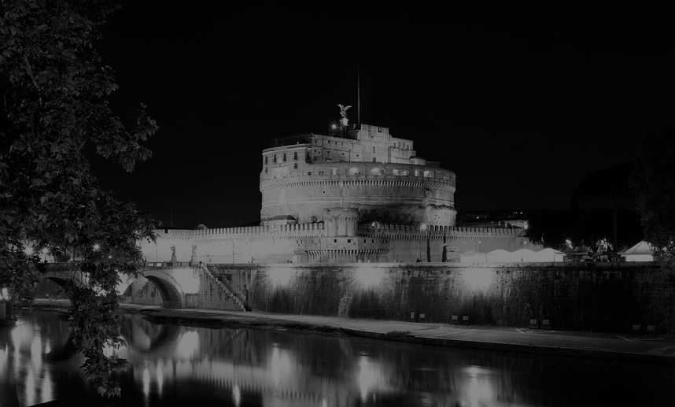
“Someone knocked.” “Only my heart,” he whispers and looks at the floor. She smiles and looks at the window again. Shadows are on her face. It makes her skin look even paler. But he has never seen her during daytime so he can’t really judge. Her expression doesn’t tell him anything. He has the sense that it’s good this way. If he only remembered her name. “Do you want a drink?” he asks.
“Wine,” she says.
“No,” she says.

Slide 13
“Wine,” she says and opens the door to the balcony. He pours red wine in two dirty glasses and hands her one. Both take a sip and look at the Castel Sant’ Angelo, majestically blazed with light. “What’s your name again?” he asks. “I have told you that twice already.” “Maybe I’ll get it at the third time.”
“My name is,” she says.
“I don’t think so,” she smiles.

Slide 14
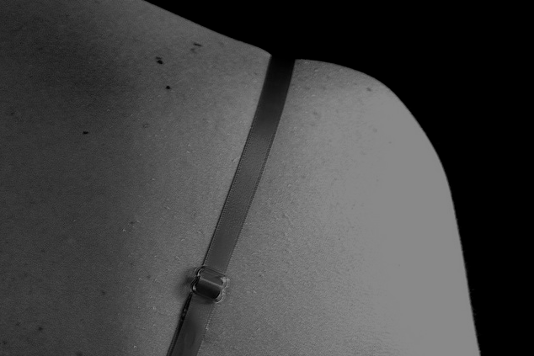
“Alba. That is my name.” Alba, of course. “What does it mean?” “It’s Spanish for dawn.” He looks at her and studies her face. It’s too dark to see the color of her eyes. He can only see the lights of Castel Sant’ Angelo in them. Her lips seem dry but are unusually red because of the wine. She is about thirty, he thinks. He puts the right strap of her light blue dress back on her shoulder. She steps back.
“I should go now.”
“I’m sorry,” he says.

Slide 15
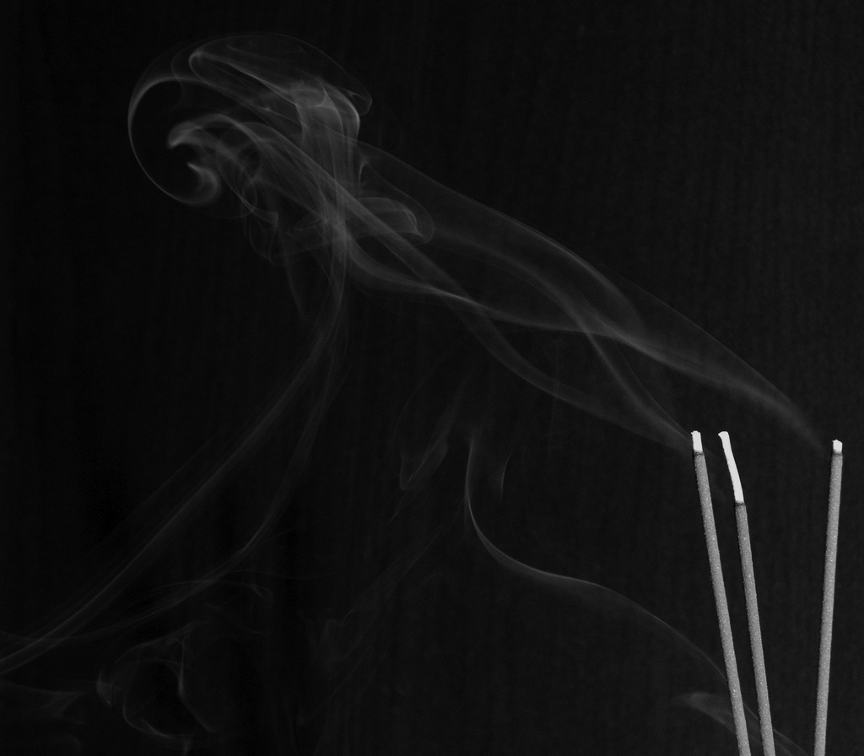
“I’m sorry,” he says. “I am engaged,” she blurts out like a child who couldn’t keep the secret anymore. “Why are you here then?” She takes his hand and gets closer to his face. Her scent reminds him of the sandalwood incense sticks his mother used to burn all over the house because the smell calmed her down. “I don’t want this to affect my life.” “And how do you do that?” “By agreeing. The two of us.” She kisses him and the wrong memory of her grows together with his mouth.
His point-of-view
Her point-of-view

Slide 16
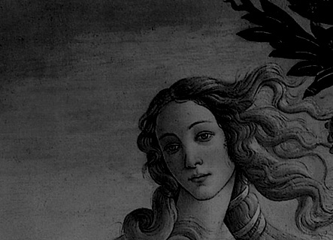
“This stays here. In this room. In these four walls,” she had said before she gave herself to the hands of a stranger. Anticipation caught fire; they fell on the bed; their hands were stiff and couldn’t find anything good to say. Venus looks at her from the ceiling. She closes her eyes because she can’t stand her look. The moon is still the only source of light in the room. Her eyes meet with Vesta’s on the right side of the room. The torch in her hand is on fire.
She gets up
She turns to him

Slide 17
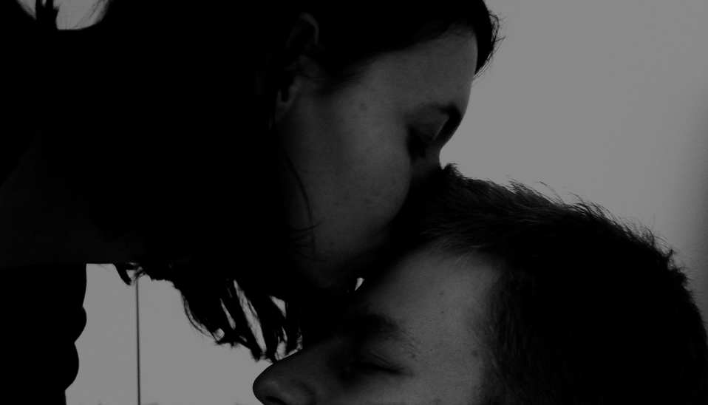
She turns to him. “Who are you?” she whispers. Quietly, she gets up and collects her clothes. After a week she has learned to be silent. She leans over and kisses his forehead. At the door, she turns around and looks at him. I don’t want to know, she thinks and closes the door if he had never lived inside her.
Write a different ending

Slide 18
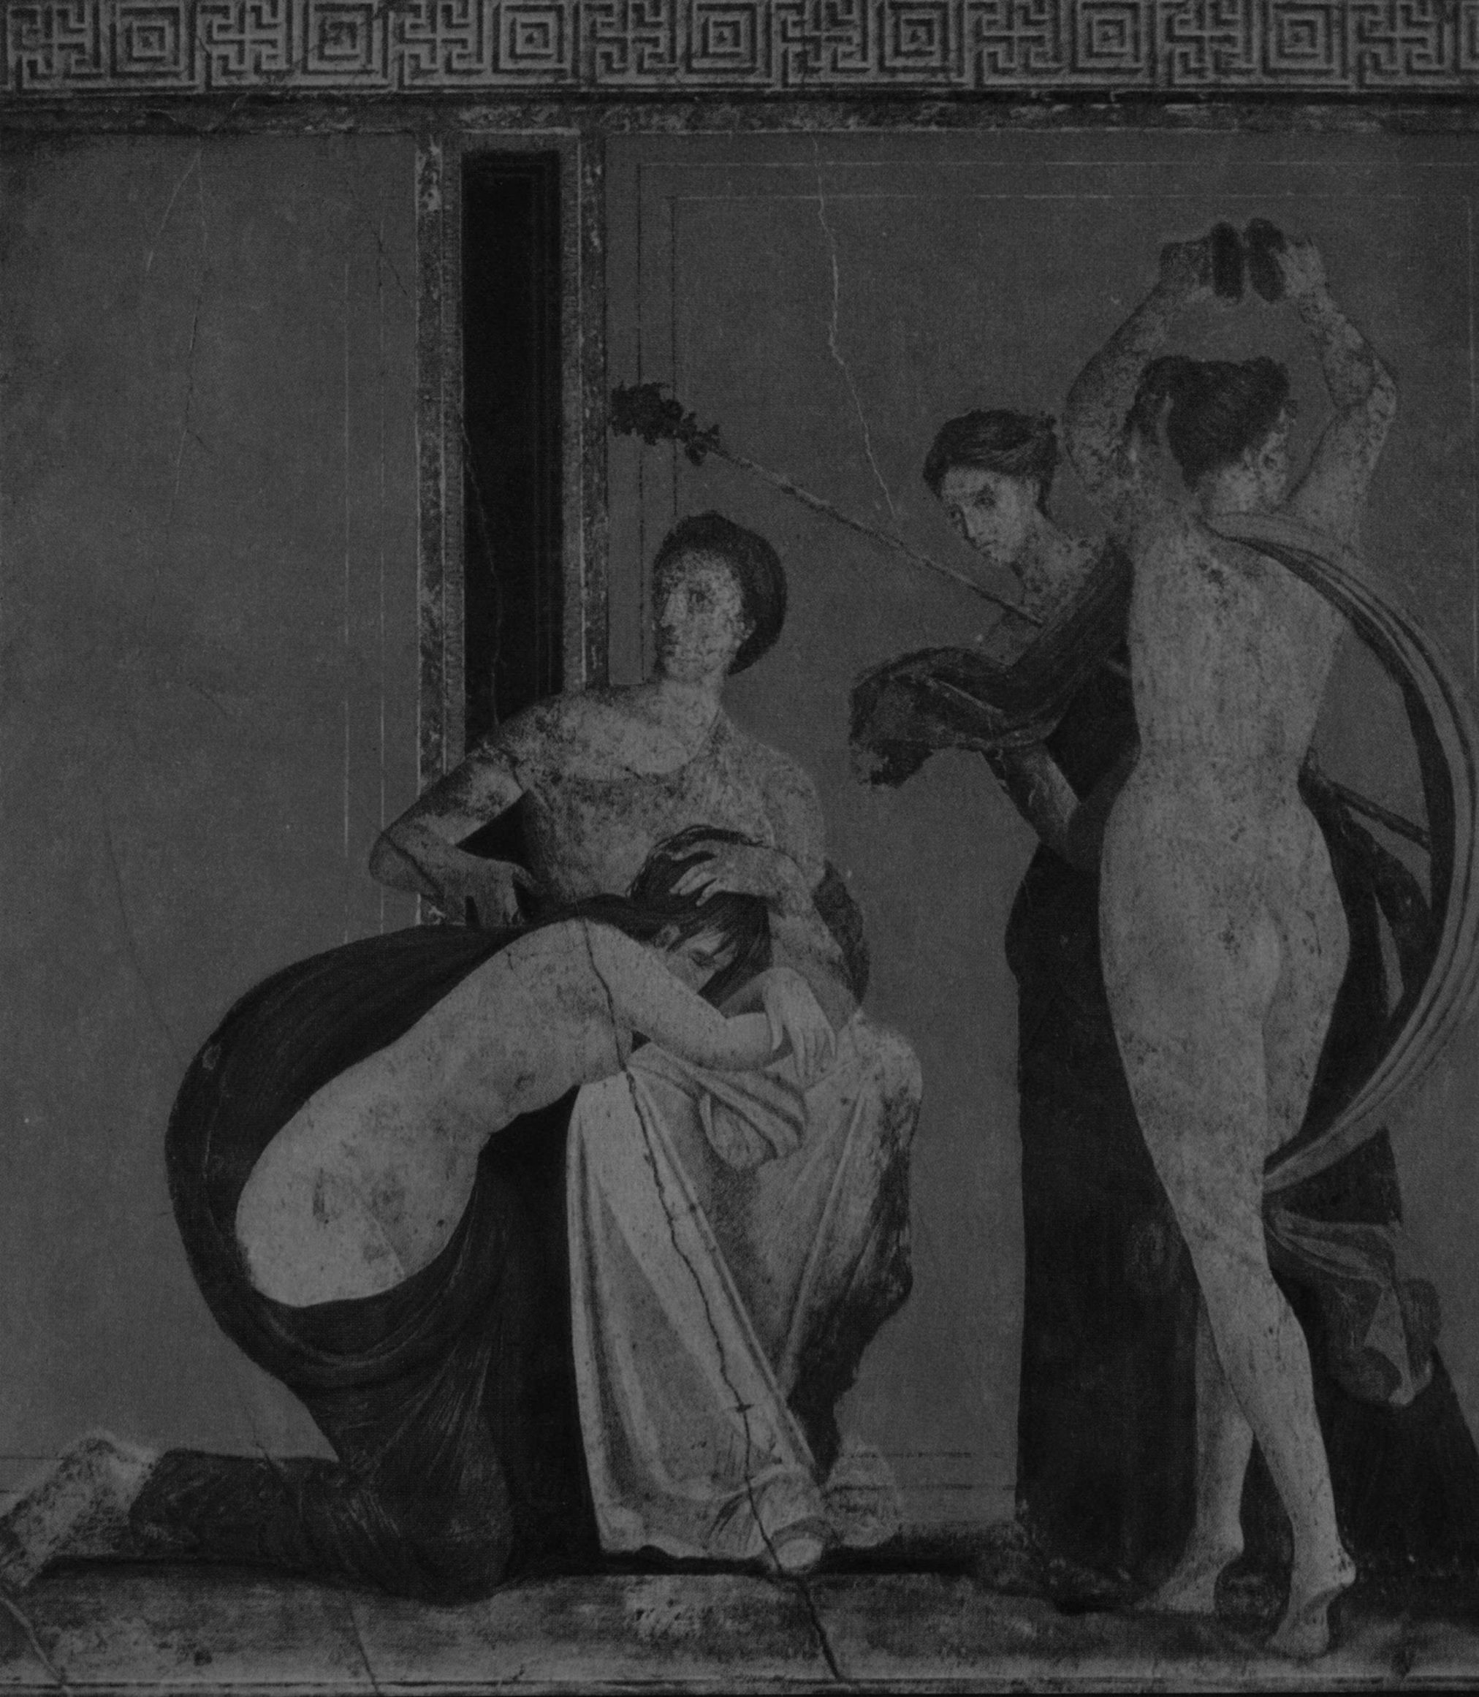
She gets up and the chilly air coming from the balcony makes the hair on her arms stand up. They float with the wisp of wind like wheat fields. She carefully touches Vesta’s face. You were brave, she thinks, two men proposed to you and both times you declined. Slowly she slides her finger over the torch. Our fire is out, she thinks.
She has been in Rome
She looks at him

Slide 19
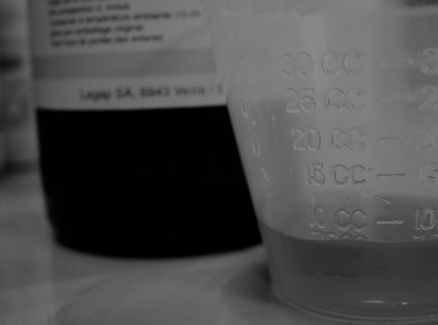
She looks at him. At his lips. His tongue tasted like grapes. A fine taste, eventually. Yesterday she tasted the cough syrup her mother used to give her when she was a child. “Who are you?” she whispers. Quietly, she collects her clothes. After a week she has learned to be silent. She leans over and kisses his forehead. At the door, she turns around and looks at him. I don’t want to know, she thinks and closes the door if he had never lived inside her.
Write a different ending

Slide 20
She has been in Rome for a week to attend a conference. She had spent her days in stuffy rooms. It reeked of cigarettes and sweat. Fat Italian businessmen sat on their chairs and pretended to understand what was being said. The growing circles of sweat coming from their armpits gave them away.
Her evenings she spends differently
It makes her think of her fiance

Slide 21
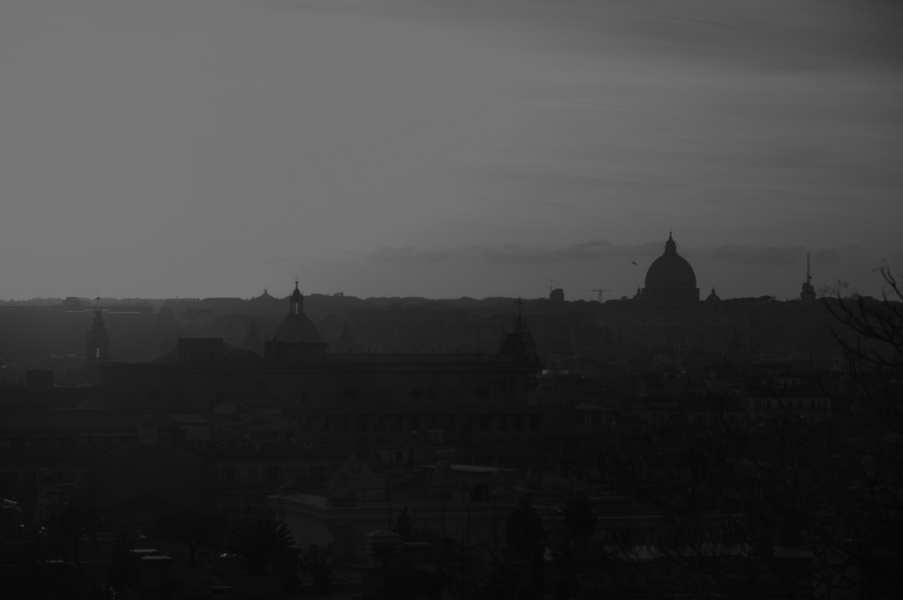
It makes her think of her fiance. Mark is soccer player and she knows what a sweaty male body smells like. She used to like it. Now she wants to be a million miles away from him. Sweaty or not. She walks out the balcony and watches the sunrise. A breeze makes her shiver. She embraces herself. The gesture makes her smile. She stands there for many moments, many thoughts. She is alone. And it’s okay.
Write a different ending

Slide 22
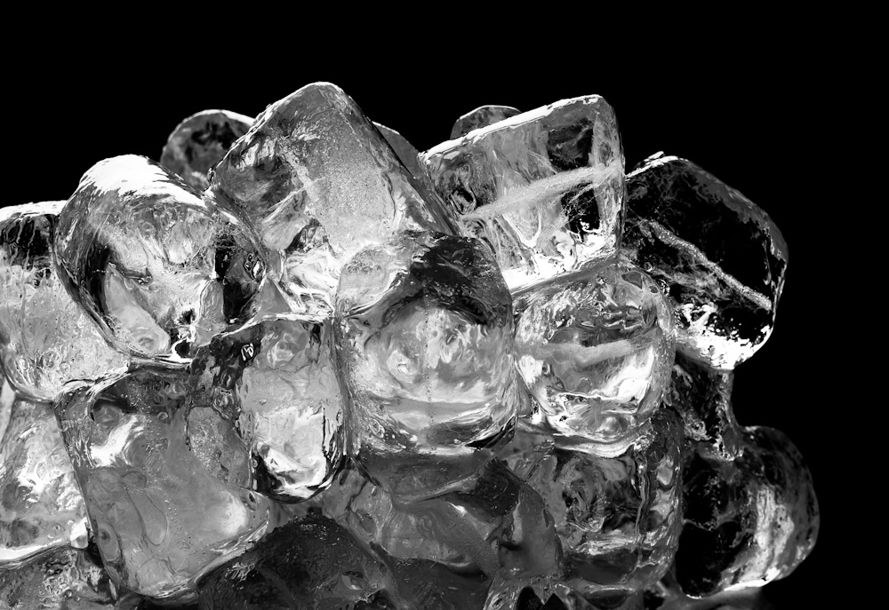
When the nights fell on the streets, the ‘We’ she knew was crawling on all fours. Every night she wore her most beautiful dresses and went for a drink. Every night she ended up in the hotel room of a stranger. “How was your night, darling?” her fiancé would ask her the next morning and she could see his frozen smile. As he couldn’t remember the argument they had before she left for Rome.
“I know 142 words for pain,”
“Short,” she says

Slide 23
“Short,” she said truthfully. “I don’t sleep well here.” “Because you can’t be without me.” He made it sound like a question but they both know it’s a statement. She pretended to have someone calling in and hung up. “I lo-” Click. “Are you okay?” the guy asks.
She nods
“It’s time to go,”

Slide 24
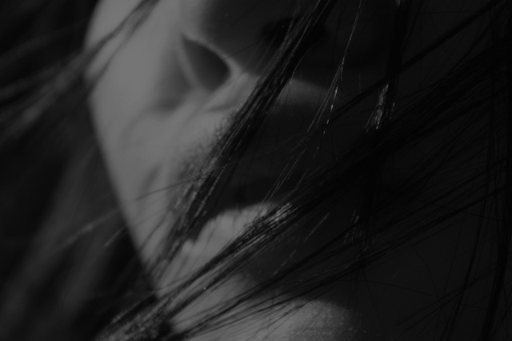
She nods. He kisses his hand and, slowly, makes his way up her arm, shoulders, neck before his lips meet hers. Bitter, she thinks. She closes her eyes when he takes her into an oblivious world. Even if it’s only for a few moments. It’s enough.
Write a different ending

Slide 25
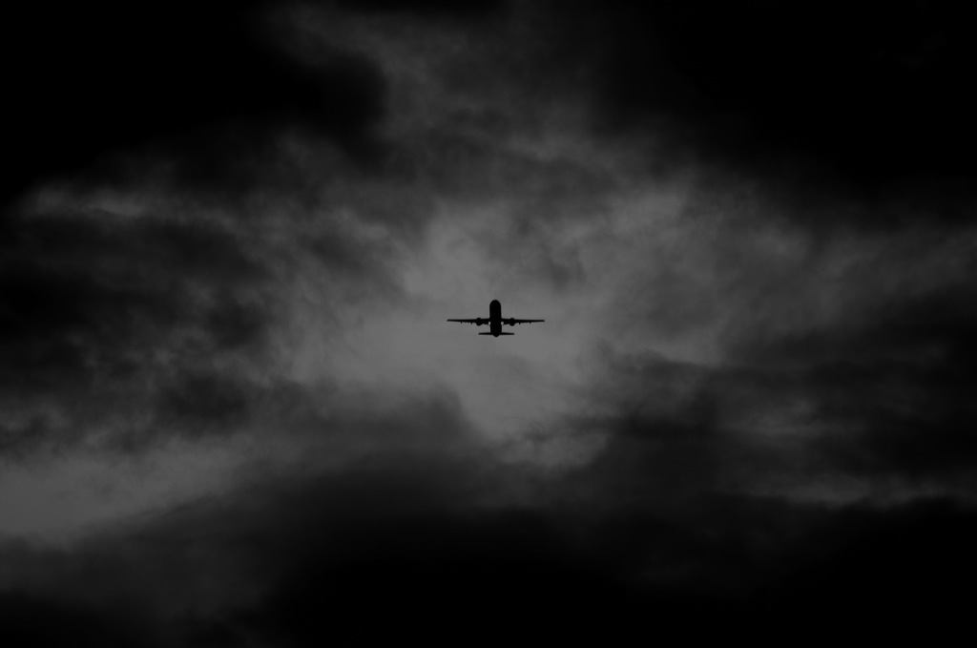
“It’s time to go,” she says. “Already?” he yawns. “Early flight.” “Right.” She collects her clothes from the floor. He watches her as she slowly gets dressed again. “Well, thank you,” he mumbles. She looks at him at the doorstep. “Thank you.”
Write a different ending

Slide 26
“I know 142 words for pain,” she said, and watched how he looked away. The compass needle on his skin always turns in the wrong direction. His toes are stapled to the floor, to the conviction that eventually everything is going to be all right. The point where they started out runs in an infinite loop and she has finally decided to fast forward. “I haven’t taken enough care of myself,” she had said to him the night before she left. In her face was a shiftless smile. I wish I could put your thumb in my mouth and sleep, she thought.
Here she can’t sleep either
She looks around the room

Slide 27
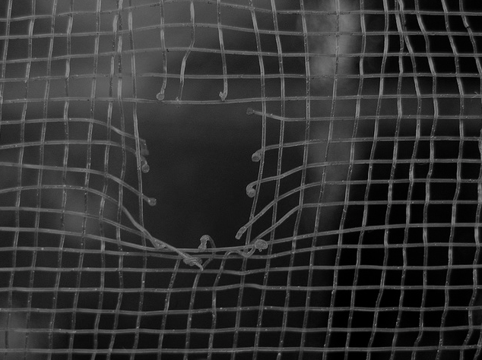
Here she can’t sleep either. Mark is stealing her sleep. He is a cunning thief but after a while she learned how to predict his next coups. It’s too late to escape him, she thinks as she looks at the stranger next to her. Then, she smiles. No, it’s not. No, it was not.
Write a different ending

Slide 28
She looks around the room. Minerva seems to wave at her from the left wall. It’s either war or peace, she thinks and goes back to bed. He is still asleep and the first one who doesn’t snore. She has forgotten his name and she doesn’t bother to ask him. His tongue tastes like grapes. She has made a list over the week. Cough syrup, coconut, almonds. On Wednesday she wanted to stop when she tasted anise cookies.
She takes his hand
Guy was his name

Slide 29
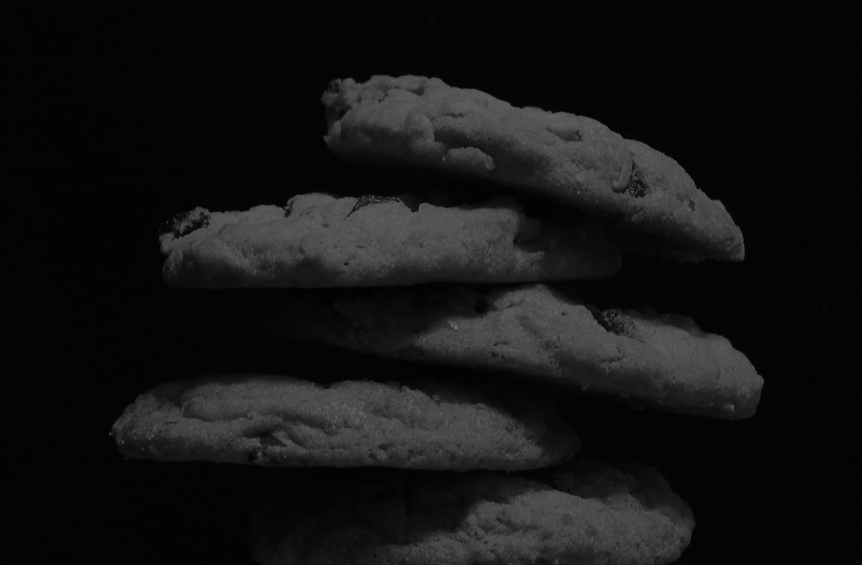
Guy was his name. It probably isn’t his real name. She doesn’t care about their names until she leaves them. Instead of asking them, she gives them names. Guy bored her. The taste of anise cookies made him interesting so she took him to his hotel room. The cookies remained to be the only interesting thing about him. As she gets ready to leave Number 5 she looks at him intensely. “Gabe,” she whispers and wonders if she will ever ask after someone’s real name.
Write a different ending

Slide 30
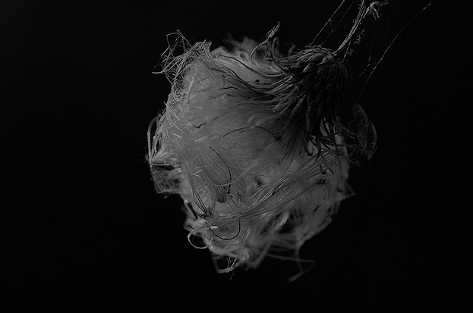
She takes his hand and lets her finger wander over his veins. A beam of light touches her face. Slowly she is sliding along the thistly parts of his hands back to reality. I think your name is Dave, she whispers and gets up to collect her clothes from the floor. Her shadow will stay next to him until he wakes up.
The wind slaps her
It’s dawn.

Slide 31
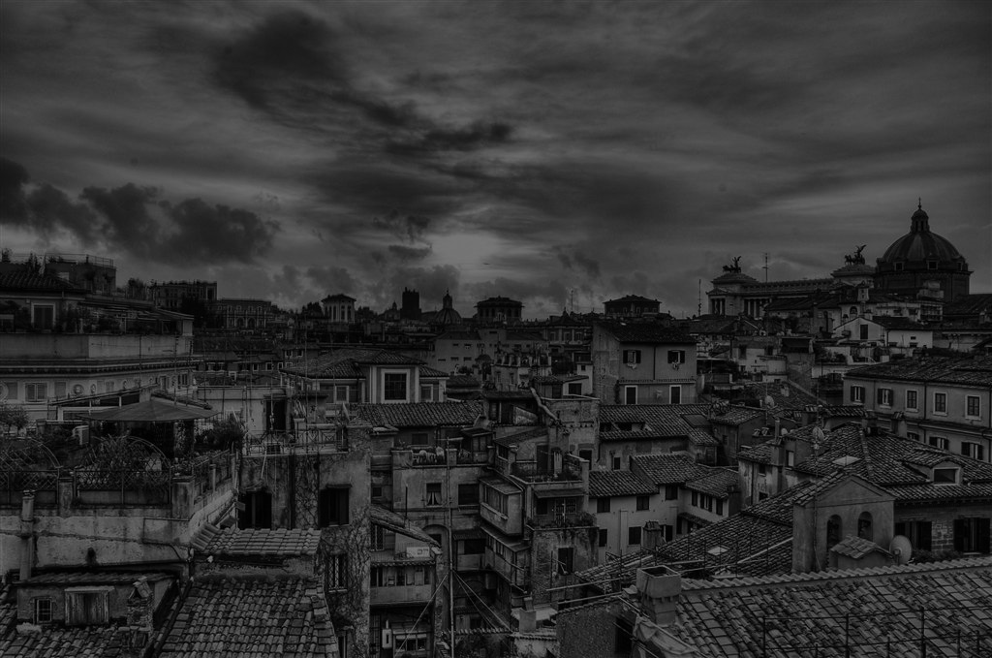
It’s dawn. She looks at him. “I think your name is Dan,” she whispers. It’s time to go, she thinks and gets dressed. She walks up to him. “Take care, Dan,” she whispers in his ear. She closes the door behind her, so quietly as if he had never lived inside her.
Write a different ending

Slide 32
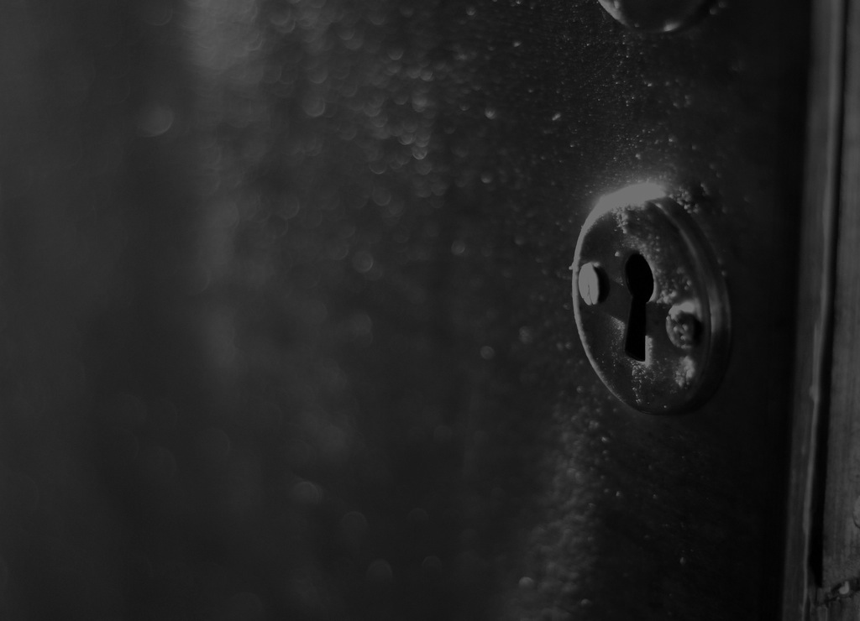
The wind slaps her in the face; a knot cords up in her throat and shadows rise from the ground. The hair on her arms beats in the fast rhythm of her heart. Juno withers her with a look and a knowing smile in her face. The blue peacock has spread its wings and the eyes riddle her. It’s time to go, she thinks, and smiles triumphantly at Juno. She walks up to him. “Take care, Dave,” she whispers in his ear. She closes the door behind her, so quietly as if he had never lived inside her.
Write a different ending

Slide 33
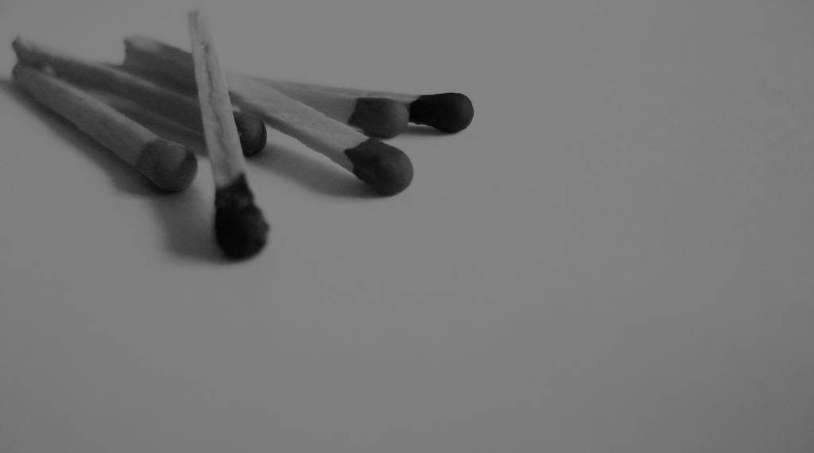
His eyelids get heavier. I wish I had match sticks, is his last thought before he falls asleep. A loud slam in the hallway rouses him from his deep sleep. With his hand on his aching forehead he looks around the room. “Hello?” he whispers awkwardly. No answer. She’s gone.
Write a different ending

Slide 34
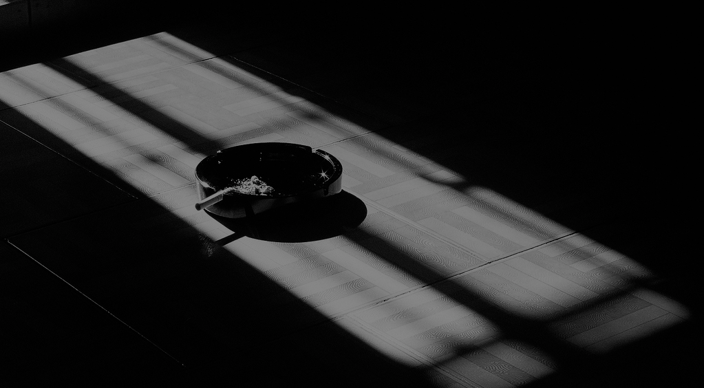
She looks in the mirror. Her auburn hair she had washed with her favorite coconut shampoo before she went for a drink now smells like an ashtray. She feels sober but experience tells her that she is not. At least the last one is handsome, she thinks. He is waiting for her in the room. “I’m doing a month of travelling before I start looking for a job,” he told her at the bar. It is his first night in Rome. He has more grace than the others, only ordered red wine. She can’t remember what else he told her about him.
They are in her hotel room
They are in his hotel room

Slide 35
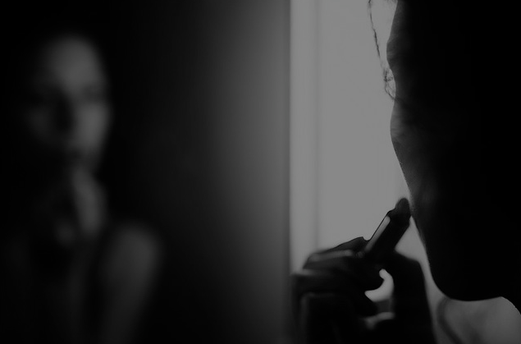
She enjoys taking them to her hotel room. It feels like walking home with a trophy every evening. His curly, dark brown hair and his doe eyes have been her best shoot yet. A young college student who admires her, the older woman. She refreshes her wine red lipstick, presses her lips together and walks out. She doesn’t want to let him wait too long. “Sorry, I –” He is gone.
Write a different ending

Slide 36
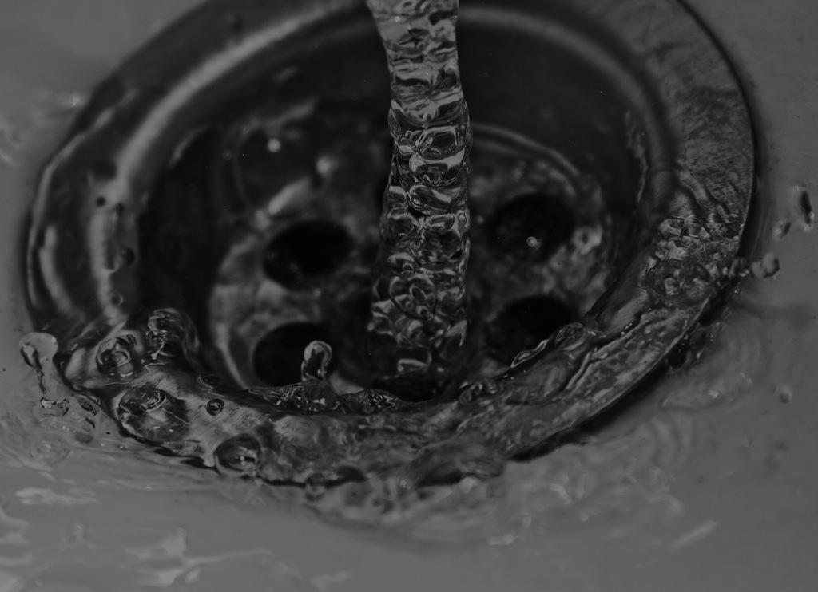
His hotel room is the cheapest she’s been to this last week. The bathroom has a white bathtub without a shower curtain. The tap for cold water doesn’t work anymore and the boiling hot water made her cry out. He didn’t react to it. “Maybe he is asleep,” she thinks and looks in the scratched mirror for the last time before she opens the door.
She smiles at him
He is gone

Slide 37
He is gone. A sigh makes her sink down. She looks around the empty room, the unmade bed and the duplicate of “The birth of Venus” above. Venus smiles triumphantly. She walks to the bed and finds a note. “You shouldn’t do this,” it reads. “I ordered you a cab.” He signed with James. Next to it she finds her engagement ring that she took off before she went to the bar. She takes her purse and leaves the room. “Thanks, James,” she says before she closes the door.
Write a different ending

Slide 38
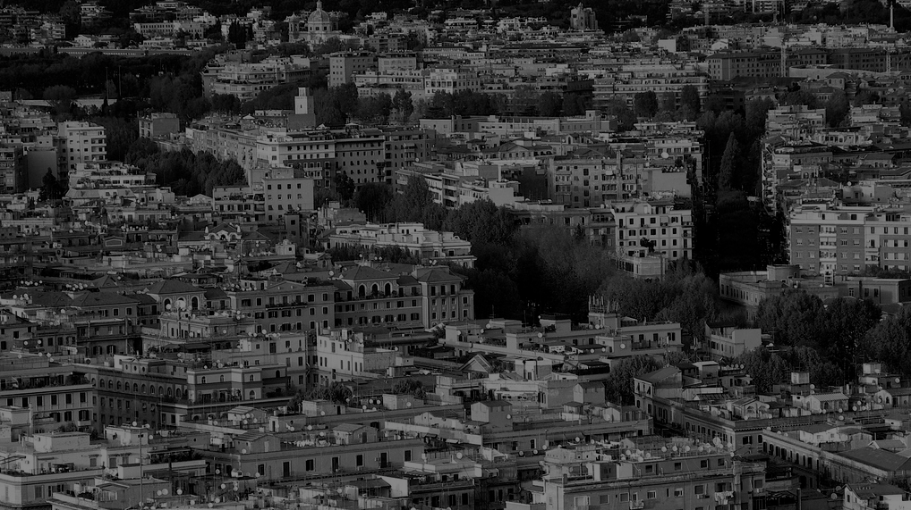
She finds him lying on the bed and smiles at him. “I hope you are not asleep,” she says. Startled, he quickly gets up. “No.” he says with an innocent smile. She raises her left eyebrow and walks up to the balcony door. She slowly walks along the room, notices the Roman goddesses all over the wall. “We have an audience,” she whispers aroused. A cold breeze fills the room when she opens the door. She steps outside the balcony. “What a great view,” she says and looks over the old city. He is right behind her. “I’m not sure if we should do this.” “Why’s that?”
She turns around
“I have a girlfriend”

Slide 39
“I have a girlfriend,” he says, embarrassed. She looks at him for a while. Idiot, she thinks. “I should go then,” she says and hits his shoulder when she passes him. “I’m sorry. You are beautiful, really. And I want to-” “Oh my. You are right, we shouldn’t do this,” she interrupts him and grabs her purse. She slams the door behind her. This will take longer tonight, she thinks as she heads back to the bar.
Write a different ending

Slide 40
She turns around and stares at him. He can’t stand her look for no longer than a few seconds before his eyes fixate the floor. “I have never had a one-night-stand before.” She laughs silently and takes a step closer to him. “There is nothing wrong with that.” She kisses him and the wrong memory of her grows together with his mouth.
His point-of-view
Her point-of-view

Slide 41
She is still asleep. Softly he touches her cheek. It’s red and warm as if she had a fever. He has never slept with an older woman. Not that she is much older but he feels proud. It’s different. Not like it was with Julie or Rachel. Or Marie. And certainly not Kate. He lifts his head to see if it’s still dark. Twisted with pain he gets back in his prior position. Alcohol would be so much better without the hangover, he thinks and turns to her again. She is awake.
“It’s time to go.”
She smiles at him.

Slide 42
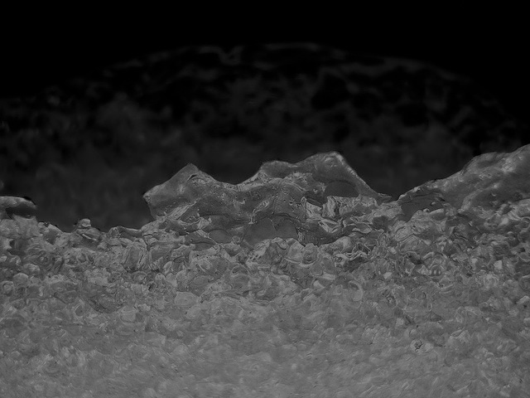
She smiles at him for a moment before her expression freezes. Her cell phone rings. She doesn’t move. All the warmth is gone. He raises his eyebrow. “Are you-” “I need to go.” She interrupts him and hastily collects her clothes. “What’s wrong?” She doesn’t answer him before she opens the door. “I’m sorry,” she says and disappears. “But – I don’t even know your name.” She’s gone.
Write a different ending

Slide 43
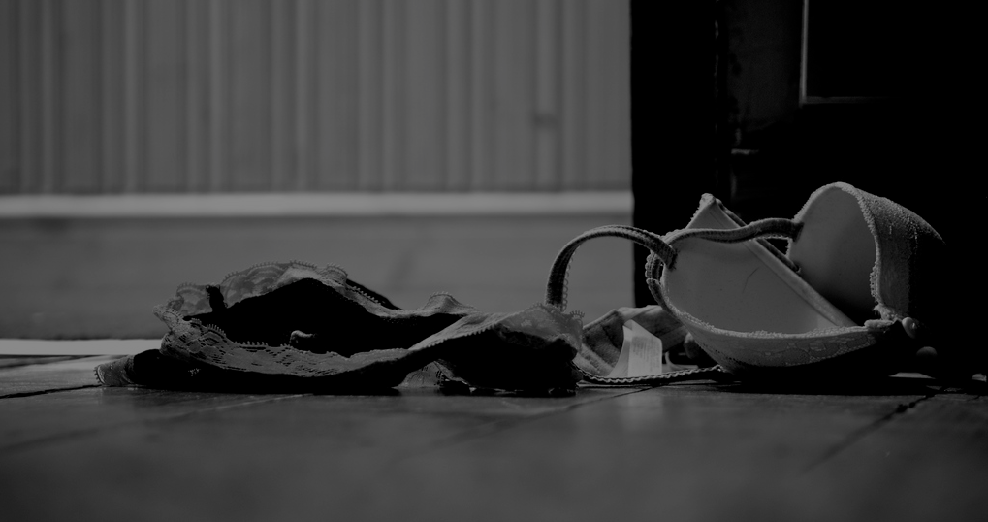
“It’s time to go,” she says and yawns. “Already?” “Early flight.” “Right.” She smiles, gets up and collects her clothes. He watches her how she slowly covers her body again. Bra. Dress. G-String. Stockings. “What’s your name again?” he asks. She looks at him and shakes her head. “Take care,” she says and bends over to give him a kiss. She leaves. And he wonders if she was really here.
Write a different ending

