Slide 1
FIND THE RIGHT HOUSEPLANT FOR YOU
What size houseplant are you looking for?
SMALL
Up to 12” tall
MEDIUM
12-24”
tall
LARGE
Over 24”
tall

Slide 2
Do you have small children or indoor pets?
YES
NO

Slide 3
Do you travel often?
YES
NO

Slide 4
Do you travel often?
YES
NO

Slide 5
You like to keep the temperature of your home:
WARM
COOL

Slide 6
You like to keep the temperature of your home:
WARM
COOL

Slide 7
You like to keep the temperature of your home:
WARM
COOL

Slide 8
You like to keep the temperature of your home:
WARM
COOL

Slide 9
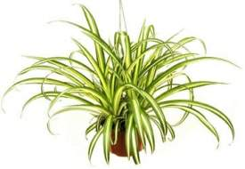
Your ideal houseplant is the
Spider Plant
Click the video below to learn how to care for your new plant:
Click here to start over

Slide 10
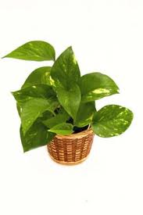
Your ideal houseplant is the
Golden Pothos
Click the video below to learn how to care for your new plant:
Click here to start over

Slide 11
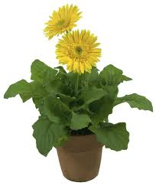
Your ideal houseplant is the
Gerbera Daisy
Click the video below to learn how to care for your new plant:
Click here to start over

Slide 12
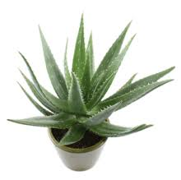
Your ideal houseplant is the
Aloe Vera
Click the video below to learn how to care for your new plant:
Click here to start over

Slide 13
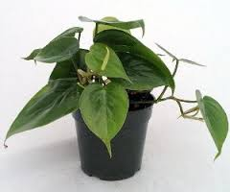
Your ideal houseplant
is the
Heart Leaf
Philodendron
Click the video below to learn how to care for your new plant:
Click here to start over

Slide 14
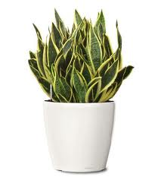
Your ideal houseplant
is the
Snake Plant
Click the video below to learn how to care for your new plant:
Click here to start over

Slide 15
Do you have small children or indoor pets?
YES
NO

Slide 16
Do you travel often?
YES
NO

Slide 17
Do you travel often?
YES
NO

Slide 18
You like to keep the temperature of your home:
WARM
COOL

Slide 19
You like to keep the temperature of your home:
WARM
COOL

Slide 20
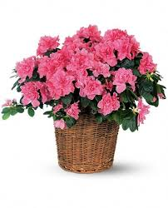
Your ideal houseplant is the
Azalea
Click the video below to learn how to care for your new plant:
Click here to start over

Slide 21
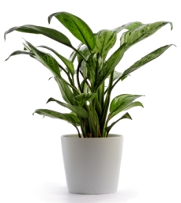
Your ideal houseplant is the
Chinese Evergreen
Click the video below to learn how to care for your new plant:
Click here to start over

Slide 22
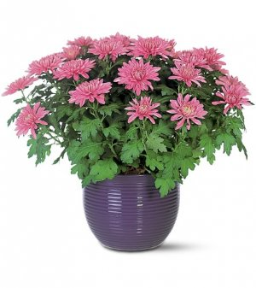
Your ideal houseplant is the
Chrysanthemum
Click the video below to learn how to care for your new plant:
Click here to start over

Slide 23
Your ideal houseplant is the
English Ivy
Click the video below to learn how to care for your new plant:
Click here to start over

Slide 24
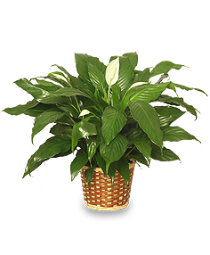
Your ideal houseplant is the
Peace Lily
Click the video below to learn how to care for your new plant:
Click here to start over

Slide 25
Do you have small children or indoor pets?
YES
NO

Slide 26
Do you travel often?
YES
NO

Slide 27
Do you travel often?
YES
NO

Slide 28
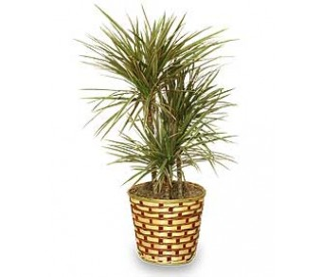
Your ideal houseplant is the
Dragon Tree
Click the video below to learn how to care for your new plant:
Click here to start over

Slide 29
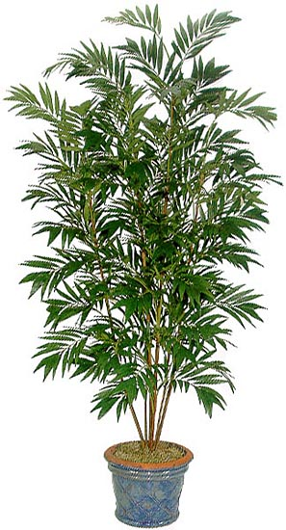
Your ideal houseplant is the
Bamboo Palm
Click the video below to learn how to care for your new plant:
Click here to start over

Slide 30
You like to keep the temperature of your home:
WARM
COOL

Slide 31
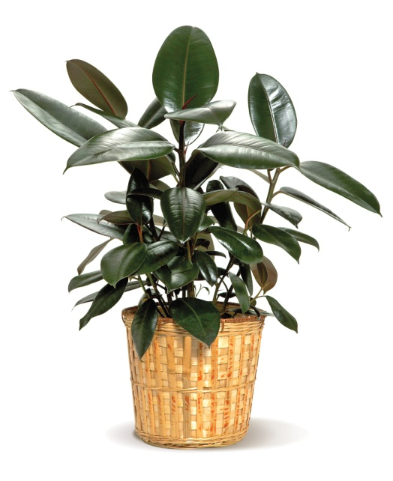
Your ideal houseplant is the
Rubber Plant
Click the video below to learn how to care for your new plant:
Click here to start over

Slide 32
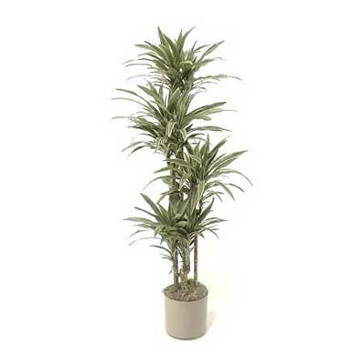
Your ideal houseplant
is the
Warneck Dracaena
Click the video below to learn how to care for your new plant:
Click here to start over

Slide 33
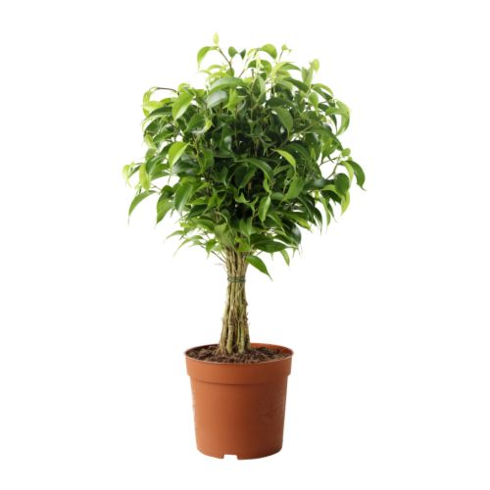
Your ideal houseplant is the
Weeping Fig
Click the video below to learn how to care for your new plant:
Click here to start over

